Slide 1


Slide 2
SUBJECT | ENGLISH
GRADE | 2 YEAR 1
TERM | 2

Slide 3
LESSON PLAN CONTENT
WEEK 1-2 | SEASONS
WEEK 3-4 | CREATURES LIVING IN WATER: OCEAN,RIVER, POND
WEEK 5-7 | ANIMALS AND THEIR SHELTERS
WEEK 8-9 | FARM AND WILD ANIMALS

Slide 4
LESSON OBJECTIVES
LISTENING AND SPEAKING
PHONOLOGICAL/PHONEMIC AWARENESS/ PHONICS
Display listening behaviour
Follow simple classroom instructions
Use visual and pictorial cues to make
Meaning
Listen to stories and respond to questions
Process information
Compare and classify information
Use language for communication
Participate in discussions
Build oral vocabulary
Develop auditory sequential memory and recall
Classify and compare sounds
Identify letter-sound relationship of single sounds (z)
Recognise words that end on -zz
Recognise and use sight words
Build and blend words three letter words

Slide 5
Cont.…
WRITING
HANDWRITING
Develop fine motor skills
Develop gross-motor skills
Draw a picture to convey messages
Imitate writing
Work with words

Slide 6
ASSESSMENT GOALS
LISTENING AND SPEAKING
PHONOLOGICAL/PHONEMIC AWARENESS/ PHONICS
Listen to stories and respond to questions
Use visual and pictorial cues to make meaning
Process information
Compare and classify information
Use language for communication
Solve and complete ten or more piece jig-saw puzzles
Distinguish aurally between different sounds at the end of words
Listen to and repeat an auditory sequence
Compare different sounds
Segment sentences into individual words by clapping on each word
Build three letter words using short ‘-a-’ words. the taught word families
Recognise that words are made up of sounds in three letter words, e.g.t-a-p

Slide 7
Cont.…
HANDWRITING
WRITING
Make patterns, e.g. rounded, pointed, vertical lines
Trace patterns, letters and words
Copy patterns and letters onto pegboards
Copy patterns, letters and words onto paper using big movements
Trace simple outlines of pictures and shapes
Use a range of writing tools
“Write” in sand trays
Draw or paints pictures
Understand that writing and drawing are different: pretend writing represented using squiggles and scribbles
‘Read’ own writing: ‘read’ what squiggles and scribbles ‘say’
Copy known letters in own name to represent writing
Role-play writing in play situations, e.g. write lists
Understand and use the past tense

Slide 8
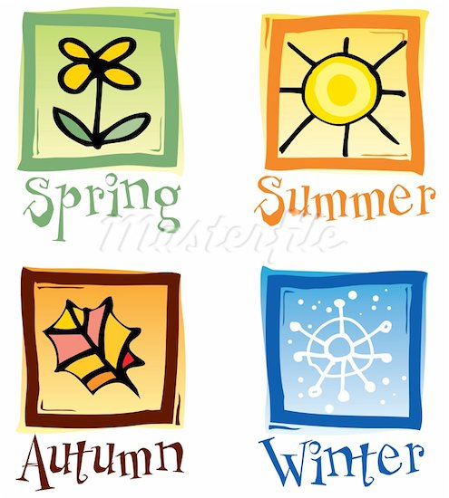
SEASONS

Slide 9
Group 1 YEAR 1

Slide 10
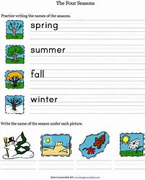

Slide 11
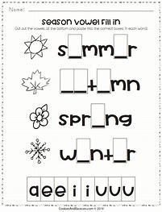

Slide 12
Group 2 Year 1

Slide 13
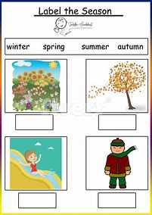

Slide 14
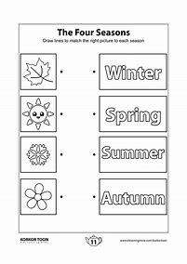

Slide 15
Group 3 Year 1

Slide 16
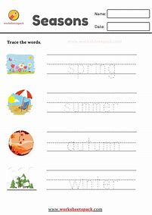

Slide 17
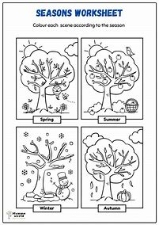

Slide 18
Group 1
Year 1

Slide 19
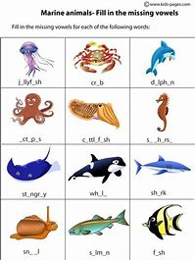

Slide 20
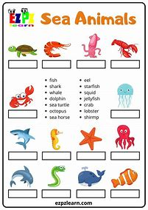

Slide 21
Group 2 Year 1

Slide 22
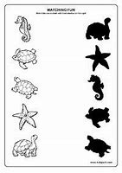

Slide 23
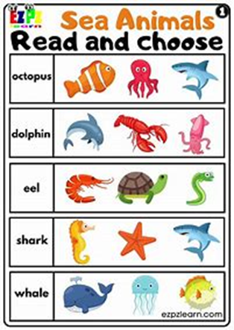

Slide 24
Group 3 Year 1

Slide 25
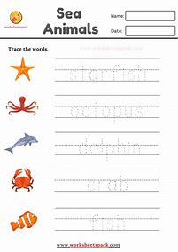

Slide 26
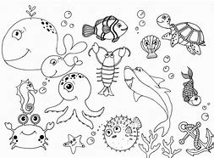

Slide 27
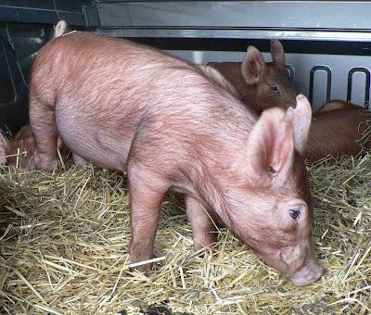
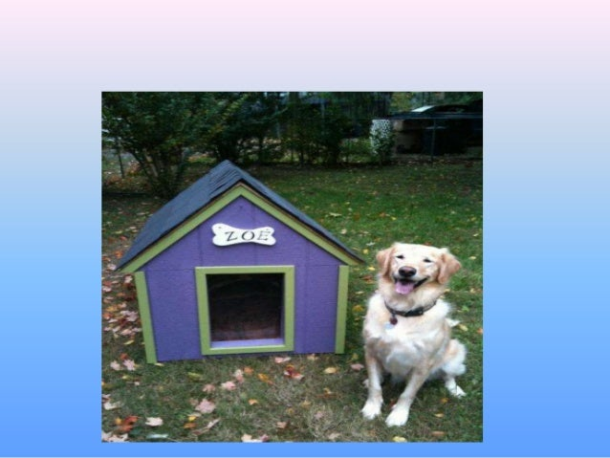
ANIMALS & THEIR SHELTERS

Slide 28
Group 1 Year 1

Slide 29
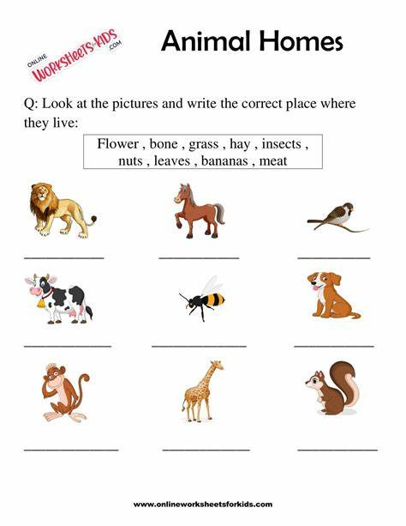

Slide 30
Group 1 Year 2

Slide 31
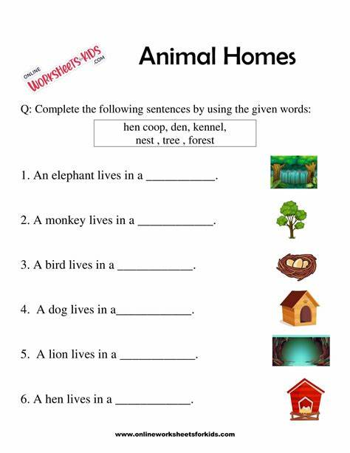

Slide 32
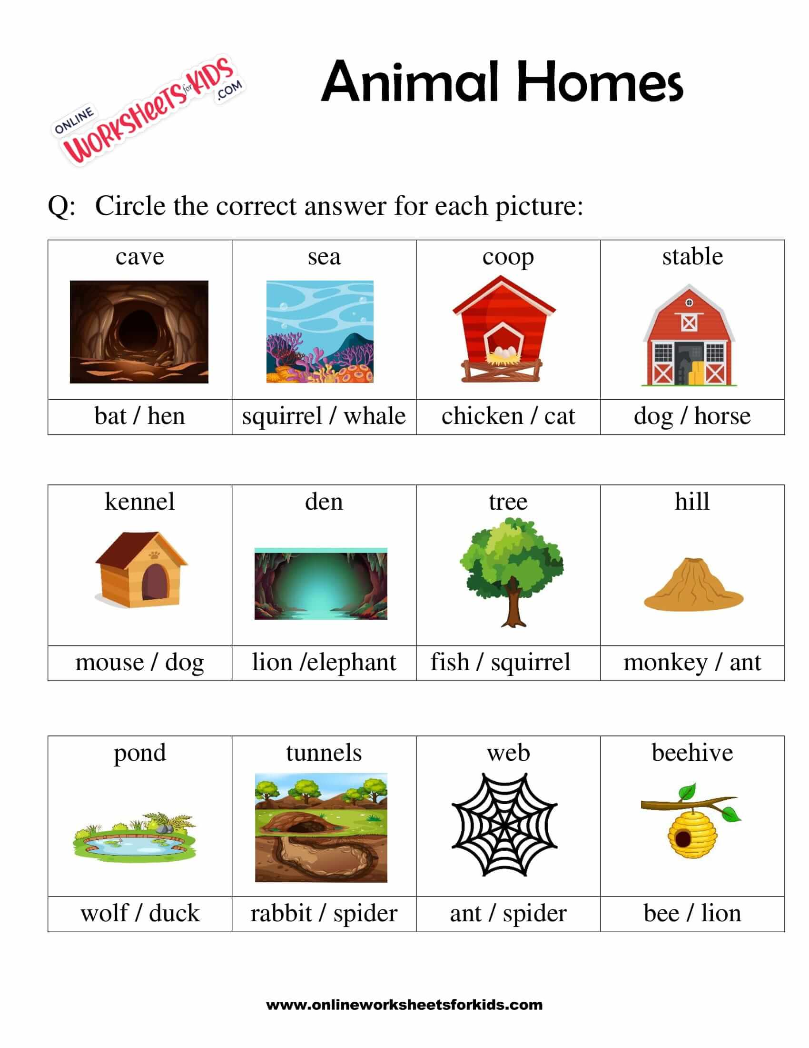

Slide 33
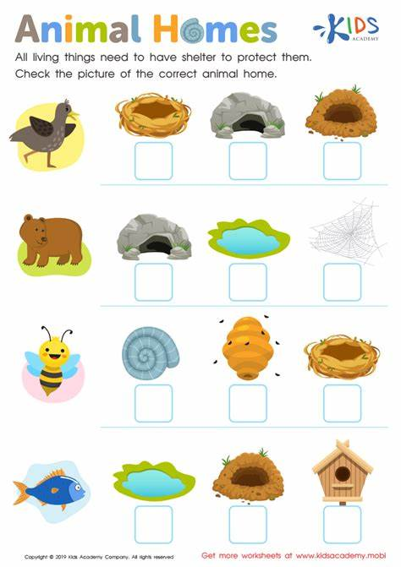

Slide 34
Group 2 Year 1

Slide 35
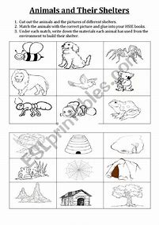

Slide 36
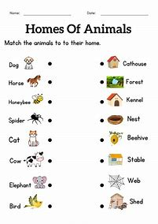

Slide 37
Group 3 Year 1

Slide 38
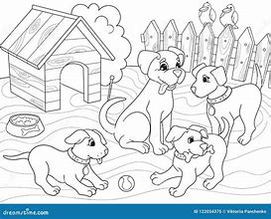
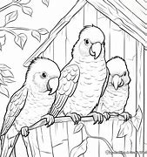

Slide 39
WILD AND FARM ANIMALS

Slide 40
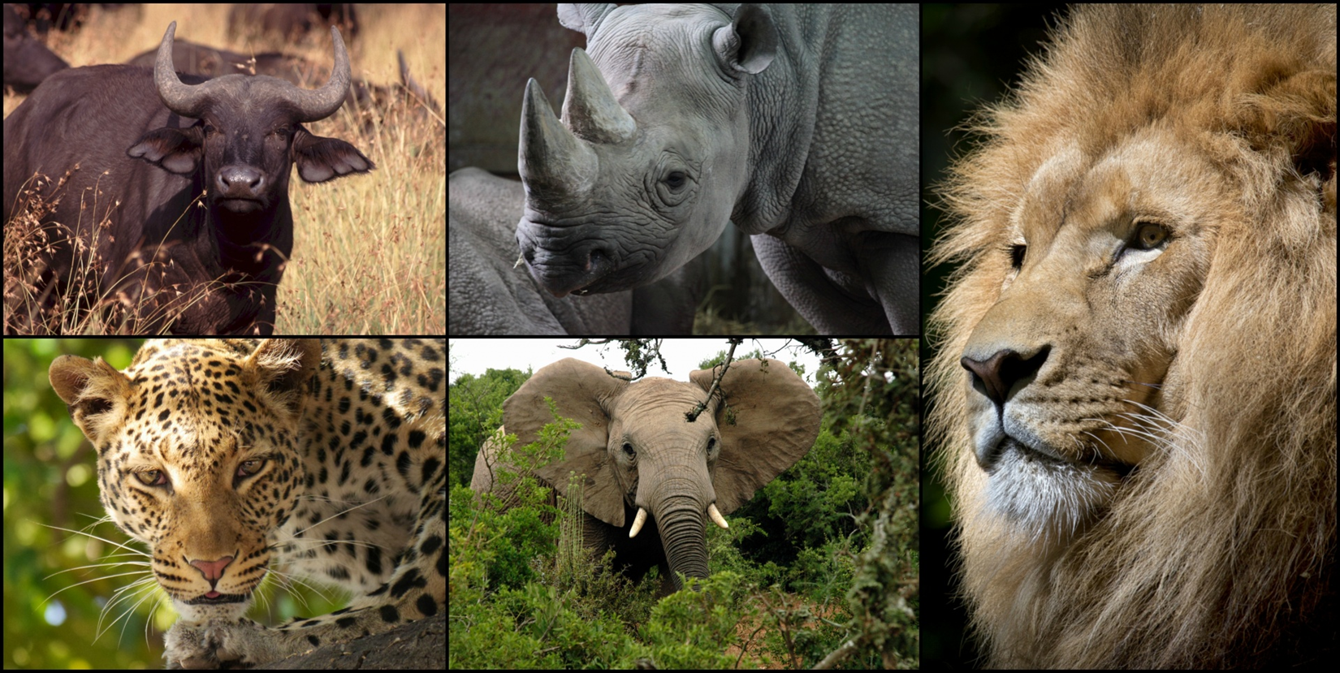

Slide 41
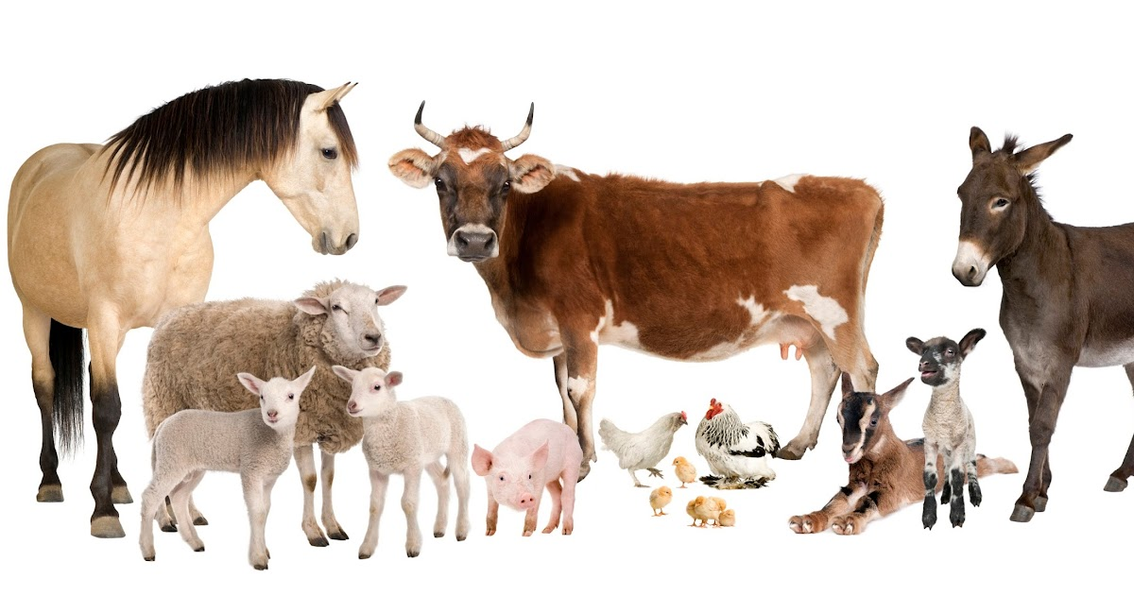

Slide 42
Group 1
Year 1

Slide 43
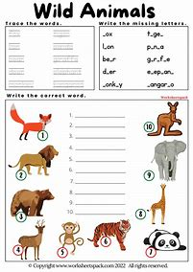

Slide 44
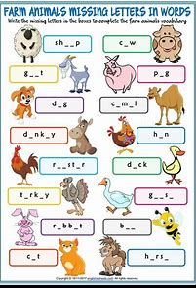

Slide 45
Group 1 Year 2

Slide 46
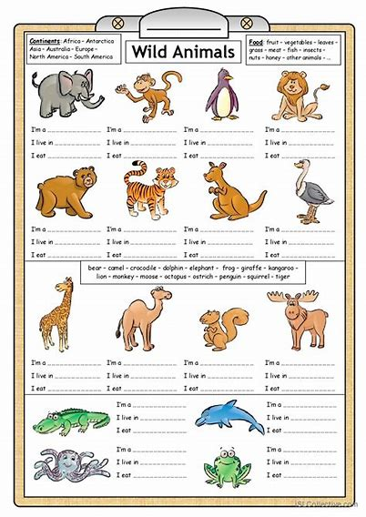

Slide 47
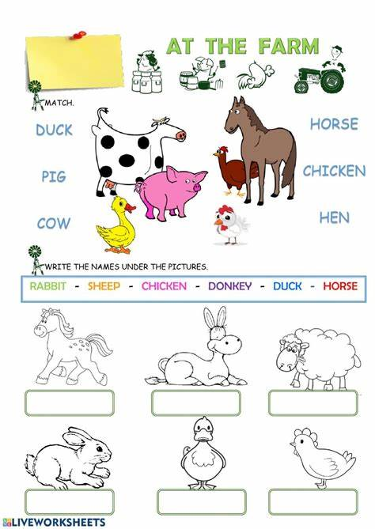

Slide 48
Group 2 Year 1

Slide 49
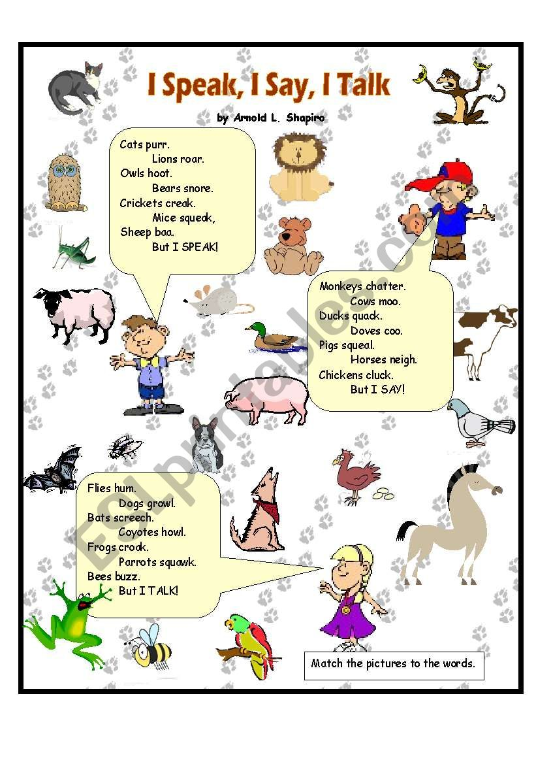

Slide 50
Group 3 Year 1

Slide 51
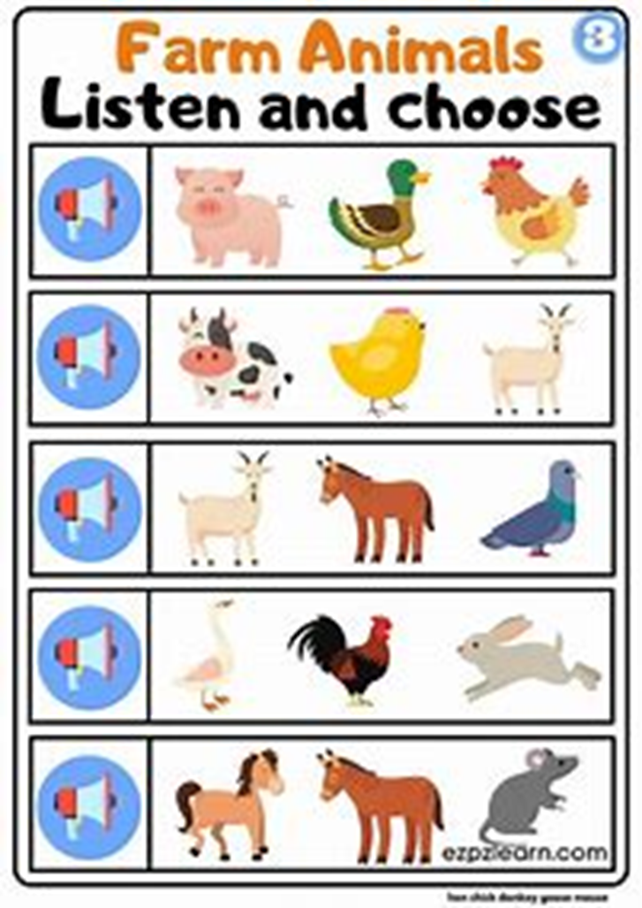

Slide 52
REFERENCES
www.Games4esl.com

